Slide 1
introduction TO BASIC WEB COMMUNICATION(0.0)

Slide 2
INTRODUCTION
Communication across the internet is possible through the World Wide Web (WWW), Web Servers, Protocols, Urls, Web Browsers etc.

Slide 3
WWW
The World wide web (WWW) is combination of all resources and users on the Internet that are using the Hypertext Transfer Protocol (HTTP).
It is an information space where documents and other web resources are identified by uniform resource locators,
and can be accessed via the internet.

Slide 4
WEB SERVER
A Web Server is a Computer that runs websites. It’s a Computer program that distributes web pages as they are requisitioned. The basic objective of the web server is to store, process and deliver web pages to the users. This intercommunication is done using Hypertext Transfer Protocol (HTTP)

Slide 5
Protocols and Standards
Protocols are “access method” or “standard path” to the resources on the world wide web.
Web browsers communicates with web servers primarily using HTTP (hypertext transfer protocol) to fetch web pages. HTTP allows web browsers to submit information to web servers as well as fetch web pages from them.

Slide 6
The file format for a web page is usually HTML (hyper-text mark-up language) and is identified in the HTTP protocol. Most web browsers also support a variety of additional formats, such as JPEG, PNG, and GIF image formats, and can be extended to support more through the use of plugins.

Slide 7
UNIFORM RESOURCE LOCATOR (URL)
This provides a way to locate a resource on
the web. The URL contains the name of the
protocol to be used to access the resources
and a resource name.
The first part of a URL identifies what protocol
to use. The second part identifies the IP Address
or Domain name where the resource is located.
https://www.clickonkaduna.ng/ is an example of a
domain name.

Slide 8
WEB BROWSER
A WEB BROWSER is a software application which enables a user to display and interact with text, images, videos, music, and other information that could be on a website.
Examples includes Safari, Google Chrome, Mozilla Firefox, Internet Explorer, etc.

Slide 9
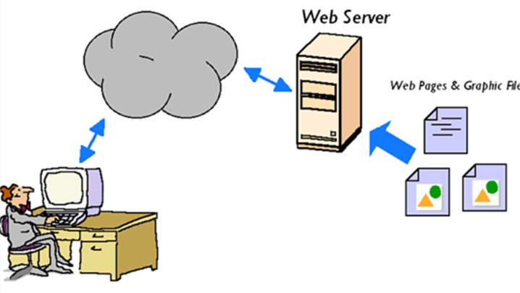

Slide 10
HTML5 AND CSS3 FUNDAMENTALS UNIT 1.0

Slide 11
WHAT IS HTML
HTML is not a programming language; it is a markup language that defines the structure of your content.
HTML consists of a series of elements, which you use to enclose, or wrap, different parts of the content to make it appear a certain way, or act a certain way.
Example: <p>My Dog is very grumpy</p>

Slide 12
HTML5
HTML5 is th latest version of Hypertext Markup Language, the code that describes web pages, as well as it’s structure.
HTML5 has been designed to deliver almost everything you'd want to do online without requiring additional software such as browser plugins. It does everything from animation to apps, music to movies, and can also be used to build incredibly complicated applications that run in your browser.

Slide 13
When will HTML5 be finished?
HTML5 is an evolving standard, so it's a bit misleading to talk about when it'll be finished.
What's important is that HTML's features - such as the aforementioned geolocation, web apps, games, video and graphics can be used now, provided your browser supports them.

Slide 14
Where can I see some HTML5 demos?
https://sketchtoy.com/
http://canvasrider.com/
https://www.w3schools.com/

Slide 15
CSS3
CSS3 is the latest evolution of the Cascading Style Sheets language and aims at extending CSS2.1.
It brings a lot of long-awaited novelties, like rounded corners, shadows, gradients, transitions or animations, as well as new layouts like multi-columns, flexible box or grid layouts.

Slide 16
Where can I see some CSS3 demos?
http://cssdeck.com/
https://paulrhayes.com
https://www.w3schools.com/

Slide 17
Browser Support for HTML5 and CSS3
https://caniuse.com/

Slide 18
UNIT 1.0 ENDS HERE

